Slide 1

Created by Aar, Amar, Filip and Shams

Slide 2

Our Elevator Pitch

Slide 3

Concept
Find out what every day people are saying about your stock of choice!
Wouldn’t it be great if you knew what other people were thinking about a stock before pulling the trigger on a stock purchase?
Our co-founder Amar always envied those who had early access to the direction of stocks on the stock market before making a trade. As a team, we devised a way to get a pulse on individual stocks to help him – and others! – be informed on the prevalent chatter on stocks.

Slide 4
Process
Our website was created using a combinationon of HTML, CSS, JavaScript, Materialize libraries and resources fetched from both Yahoo Finance and Reddit public APIs.
All four members of this team worked on all coding related aspects of this website, with individual snippets of code being added via a shared Github repository.
The primary challenge for our website was the aesthetics of how we wanted our landing page and presentation to look. Using libraries outside of our comfort level, and pivoting from our original concept to remain agile.

Slide 5

Progress
We were able to successfully create a working MVP that we can build on!

Slide 6
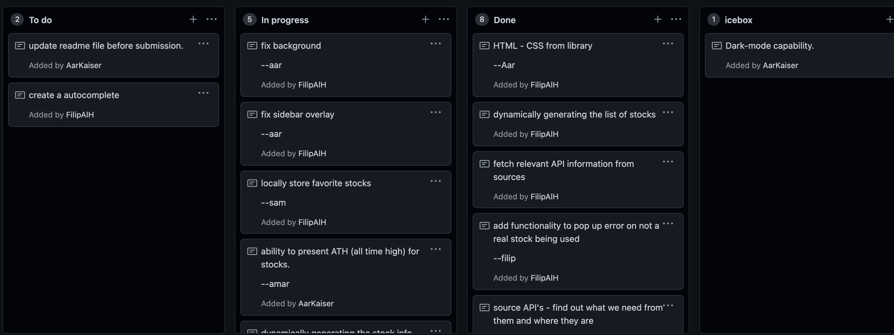
Individual Roles

Slide 7

Our MVP Demo

Slide 8
Directions for Future Development
We plan to incorporate more API sources such as Twitter, 4Chan, Google, Bing and eventually have the ability to scrape the internet for chatter.
We plan to have more functionality in terms of how the information is presented. Examples include adding comparison charts, and visual data analysis aids.
We plan to add a login feature so that our users can save historical searches and bookmark them long-term.
We also plan to add a night-mode feature for our night-owl users.

Slide 9
Links:
Stock of The Talk Website.
GitHub repo

Slide 10
The End
Thank You!

